Slide 1
NETW211 Course Project Module 4 Azure VM Security John Francis – 7/24/22

Slide 2
Rubric
Activity | Requirement(s) | Points
Launching a VM | Screenshot | 15
Connecting to the VM via SSH | Screenshot | 15
Configuring an NSG | Two screenshots | 30

Slide 3
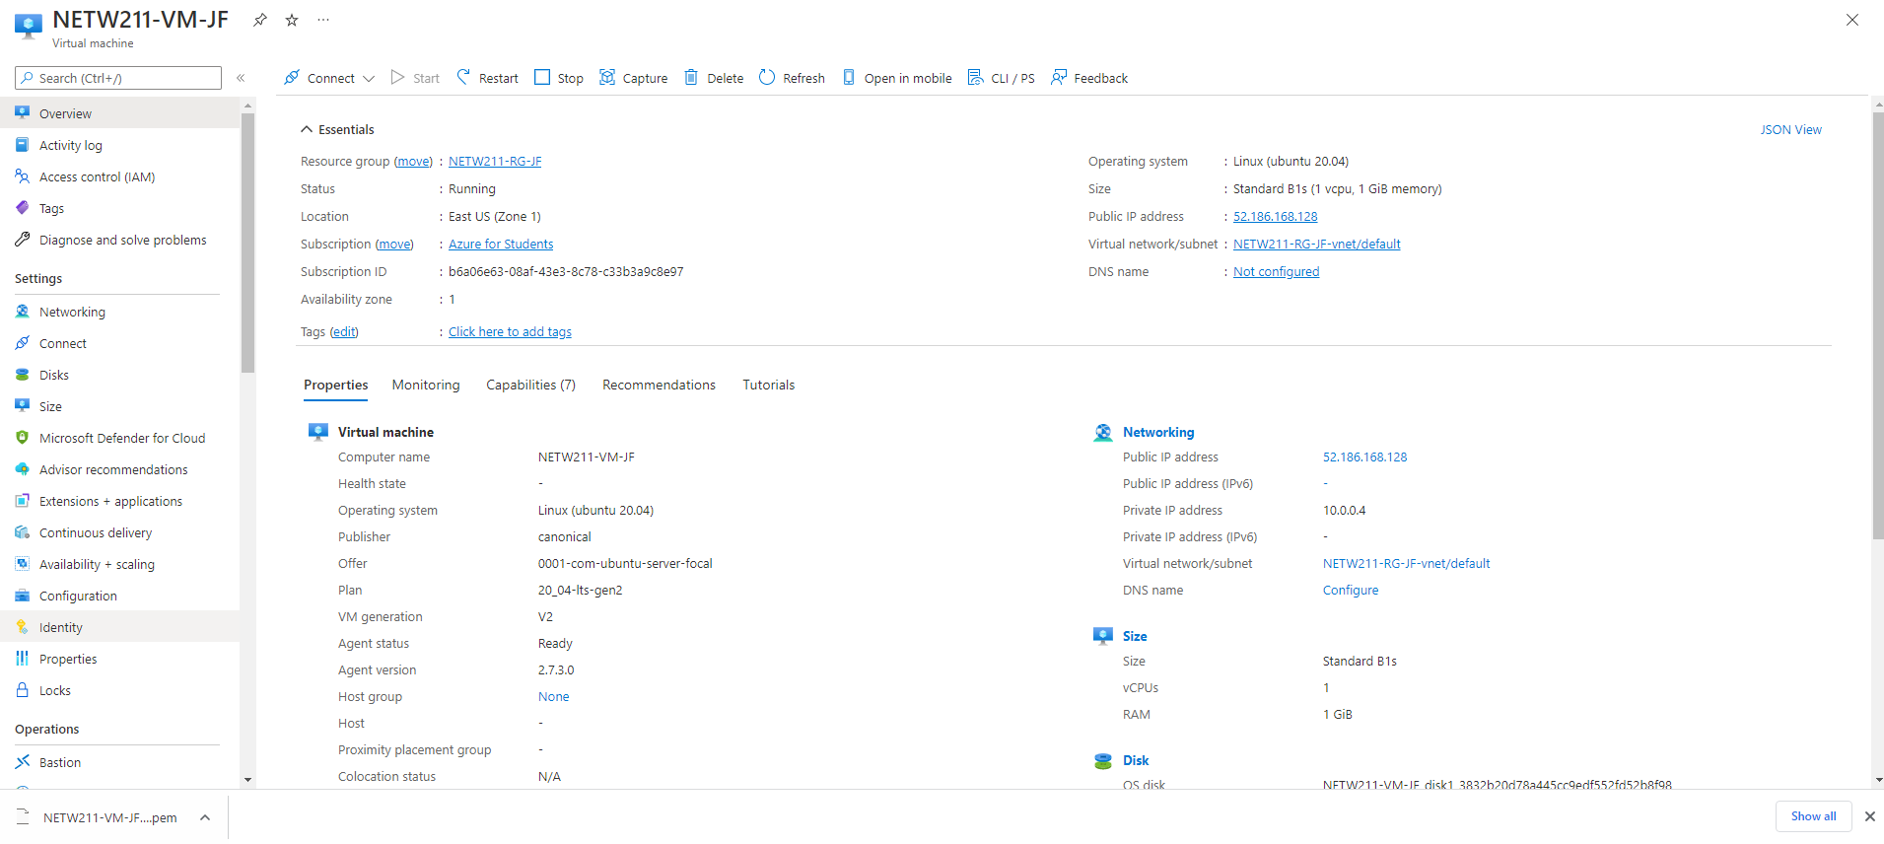
Launching a VM
This screenshot should show the NETW211-VM-Your Initials page, with information such as the resource group name, subscription, public IP address, etc.

Slide 4
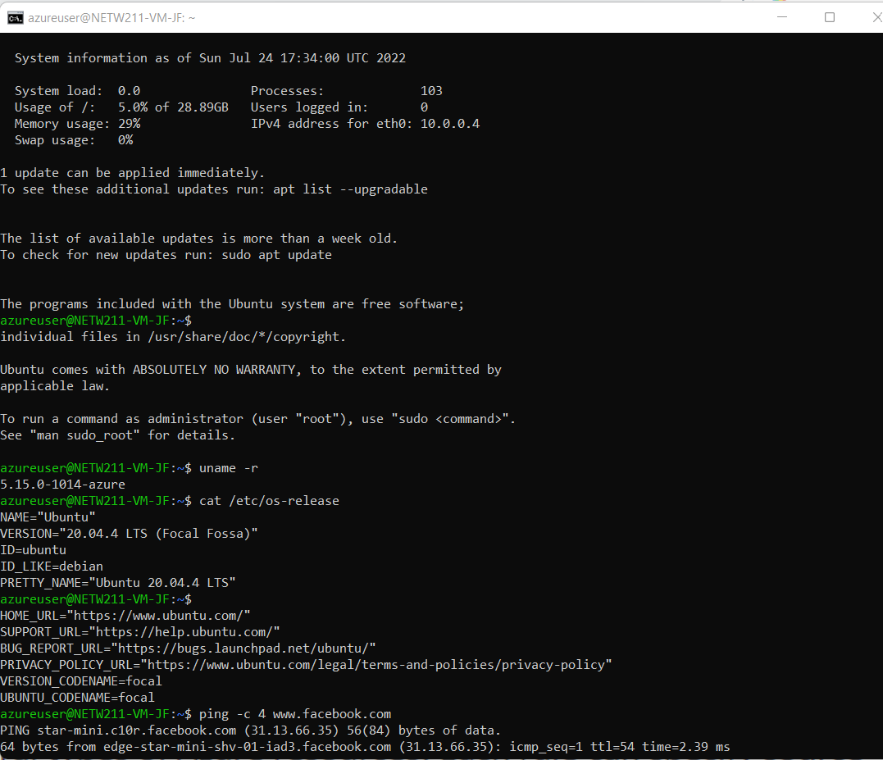
Connecting to the VM
via SSH
This screenshot should show the azureuser@NETW211-VM-Your Initials window showing the IPv4 address of the VM in the Azure cloud.

Slide 5
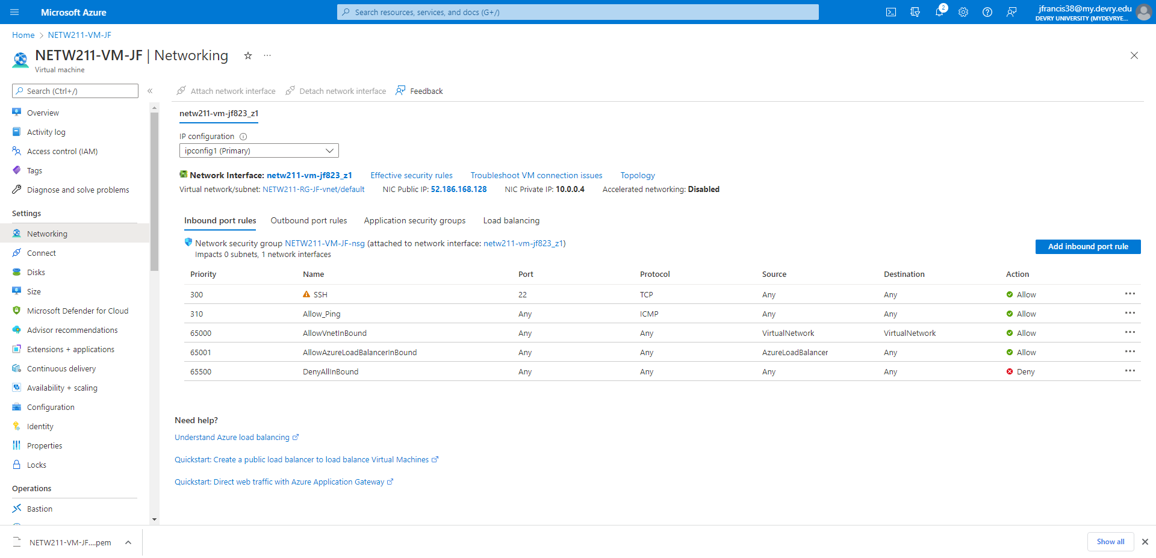
Configuring an NSG
This screenshot should show the Inbound port rules section with the newly added Allow_Ping rule.

Slide 6
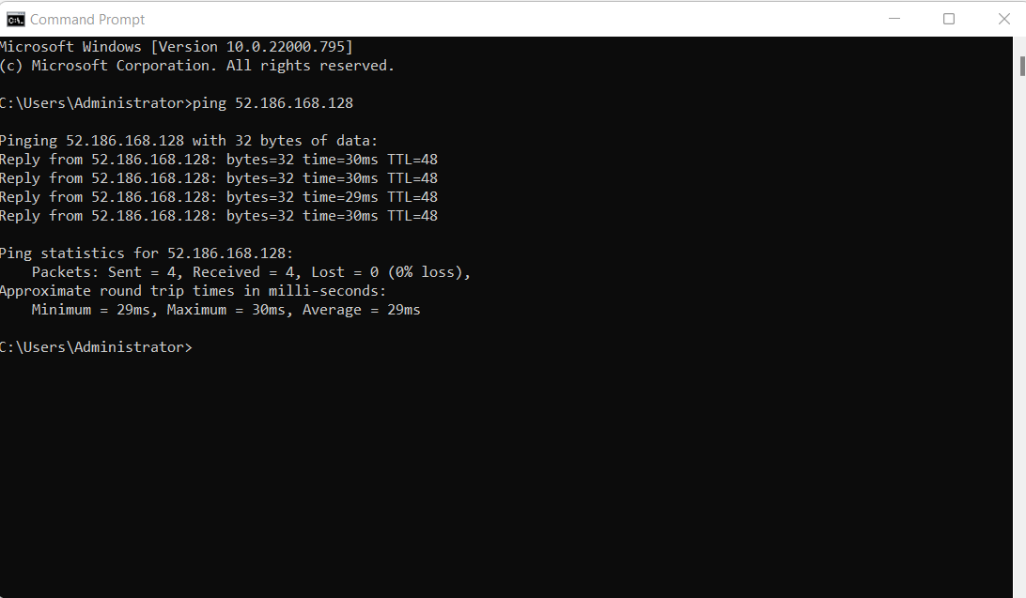
Configuring an NSG
cont’d
This screenshot should show the successful ping result from your local computer to the VM in the Azure cloud.

